Slide 1
Natural Language Processing
Jacob Eisenstein
Direct Studies - Book Report
By Mahtab Tamannaee
Winter 2021

Slide 2
Chapter 6
Language models

Slide 3
Language models
Let's consider the problem of computing the probability of text itself.
We will consider models that assign probability to a sequence of word tokens, p(w1, w2, . . . , wM), with wm ∈ V. The set V is a discrete vocabulary.
V = {aardark, abacus, . . . , zither}.
N-gram language models: A simple approach to computing the probability of a sequence of tokens is to use a relative frequency estimate.

Slide 4

N-gram language models
We begin with n-gram language models, which compute the probability of a sequence as the product of probabilities of subsequences. The probability of a sequence p(w) = p(w1, w2, . . . , wM) can be refactored using the chain rule.
Each element in the product is the probability of a word given all its predecessors. We can think of this as a word prediction task.

Slide 5


N-gram language models
N-gram models make a crucial simplifying approximation as they condition on only the past n − 1 words.
Therefore, the probability of a sentence w can be approximated as:
The n-gram probabilities can be computed by relative frequency estimation:

Slide 6


N-gram language models:
The hyperparameter N controls the size of the context used in each conditional probability.
Unigram model
Bigram Model

Slide 7
N-gram language models:
The hyperparameter N controls the size of the context used in each conditional probability. If this is misspecified, the language model will perform poorly.
Consider the following sentence “Gorillas always like to groom their friends”. The likelihood of ‘their’ depends on knowing that ‘gorillas’ is plural.
When n is too small,the n-grams are not big enough to capture this context, then the resulting language model would offer probabilities that are too low for these sentences.Small n-gram size introduces high bias.
When n is too big,it is hard good estimates of the n-gram parameters from our dataset, because of data sparsity.large n-gram size introduces high variance

Slide 8

Smoothing
A major concern in language modeling is to avoid the situation p(w) = 0, which could arise as a result of a single unseen n-gram. The solution is smoothing.
This basic framework is called Lidstone smoothing, but special cases have other names:
Laplace smoothing corresponds to the case α = 1.
Jeffreys-Perks law corresponds to the case α = 0.5, which works well in practice and benefits from some theoretical justification

Slide 9


Discount
To ensure that the probabilities are properly normalized, anything that we add to the numerator (α) must also appear in the denominator (Vα). This idea is reflected in the concept of effective counts.
Where ci is the count of event i, c ∗ i is the effective count, and M is the total number of tokens in dataset (w1, w2, . . . , wM). The discount for each n-gram is then computed

Slide 10
Discounting and backoff
Another approach would be to borrow the same amount of probability mass from all observed n-grams, and redistribute it among only the unobserved n-grams. This is called absolute discounting.
Discounting reserves some probability mass from the observed data, and we do not need redistribute this probability mass equally. Instead, we can backoff to a lower-order language model. This is called Katz backoff.

Slide 11
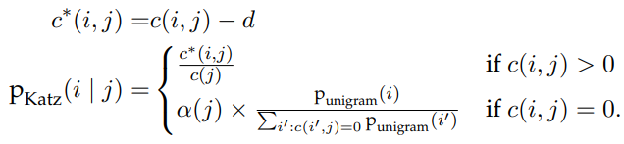
Discounting and backoff pt2
Simple case of backing off from bigrams to unigrams:
The term α(j) indicates the amount of probability mass that has been discounted for context j. This probability mass is then divided across all the unseen events, {ii : c(ii , j) = 0}, proportional to the unigram probability of each word ii.
The discount parameter d can be optimized to maximize performance on a development set.

Slide 12
Recurrent neural network language models
The first insight behind neural language models is to treat word prediction as a discriminative learning task.
The goal is to compute the probability p(w | u), where w ∈ V is a word, and u is the context, which depends on the previous words.
Rather than directly estimating the word probabilities from (smoothed) relative frequencies, we can treat treat language modeling as a machine learning problem, and estimate parameters that maximize the log conditional probability of a corpus.

Slide 13

Recurrent neural network language models pt2
The second insight is to reparametrize the probability distribution p(w | u) as a function of two dense K-dimensional numerical vectors, βw and vu. where (βw·vu) represents a dot product.
This vector of probabilities is equivalent to applying the softmax transformation to the vector of dot-products.
The word vectors βw are parameters of the model, and are estimated directly.
The context vectors vu can be computed in various ways, depending on the model.

Slide 14
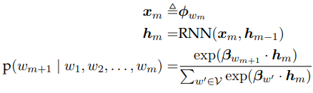
Recurrent neural network language models pt3
A simple but effective neural language model can be built from a recurrent neural network.
The basic idea is to recurrently update the context vectors while moving through the sequence.
Let hm represent the contextual information at position m in the sequence, RNN language models are defined as following:

Slide 15
Recurrent neural network language models pt4
In the following formula for RNN language models, φ is a matrix of word embeddings, and xm denotes the embedding for word wm.
The conversion of wm to xm is sometimes known as a lookup layer, because we simply lookup the embeddings for each word in a table.

Slide 16

Recurrent neural network language models pt5
The Elman unit defines a simple recurrent operation. In which, Θ is the recurrence matrix and g is a non-linear transformation function, often defined as the elementwise hyperbolic tangent tanh.
The tanh acts as a squashing function, ensuring that each element of hm is constrained to the range.
Although each wm depends on only the context vector hm−1, this vector is in turn influenced by all previous tokens, w1, w2, ... wm−1, through the recurrence operation: w1 affects h1, which affects h2, and so on, until the information is propagated all the way to hm−1, and then on to wm

Slide 17

Recurrent neural network language models pt6
The recurrent neural network language model has the following parameters:
Each of these parameters can be estimated by formulating an objective function over the training corpus, L(w), and then applying backpropagation to obtain gradients on the parameters from a minibatch of training examples

Slide 18


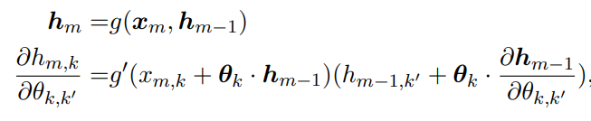
RNN LM : Backpropagation through time
Backpropagation in RNNis known as backpropagation through time. The gradients on units at time m depend in turn on the gradients of units at earlier times n < m. Let Lm+1 represent the negative log-likelihood of word m + 1.
The loss depends on the parameters only through hm.
The vector hm depends on Θ in several ways.First, hm is computed by multiplying Θ by the previous state hm−1. But the previous state hm−1 also depends on Θ

Slide 19

RNN LM : Backpropagation through time pt2
The g’ is the local derivative of the nonlinear function g.
Each derivative , will be reused many times as it appears in backpropagation from the loss Lm, but also in all subsequent losses Ln>m

Slide 20
RNN language model Hyperparameters
The RNN language model has several hyperparameters that must be tuned to ensure good performance.
The model capacity is controlled by the size of the word and context vectors K, which play a role that is somewhat analogous to the size of the n-gram context.
For datasets that are large with respect to the vocabulary, we can afford to estimate a model with a large K, which enables more subtle distinctions between words and contexts.
When the dataset is relatively small, then K must be smaller too, or else the model may “memorize” the training data, and fail to generalize.

Slide 21
Gated recurrent neural networks
The long short-term memory (LSTM) is a popular variant of RNNs that is more robust to vanishing gradients an exploding gradients problems.
Because the memory cell is not passed through a nonlinear squashing function during the update, it is possible for information to propagate through the network over long distances.
The gates are functions of the input and previous hidden state. They are computed from elementwise sigmoid activations. Each gate is controlled by a vector of weights, which parametrize the previous hidden state.

Slide 22
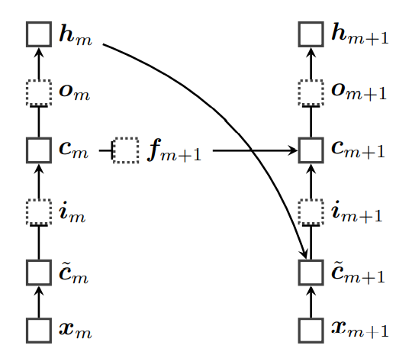
Gated recurrent neural networks
This model augments the hidden state hm with a memory cell cm. The value of the memory cell at each time m is a gated sum of two quantities: its previous value cm−1, and an “update” c˜m, which is computed from the current input xm and the previous hidden state hm−1. The next state hm is then computed from the memory cell.

Slide 23
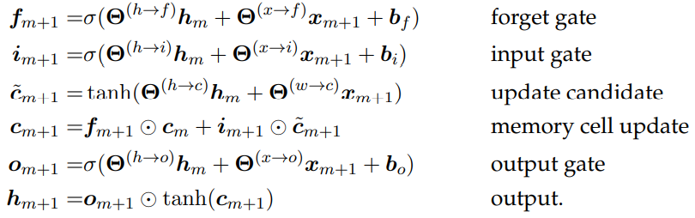

Slide 24
Evaluating language models
Language models are typically components of larger systems. They would ideally be evaluated extrinsically. But this is often hard to do, because extrinsic evaluation depends on details of the overall system.
In contrast, intrinsic evaluation is task-neutral.
Better performance on intrinsic metrics may be expected to improve extrinsic metrics across a variety of tasks, but there is always the risk of over-optimizing the intrinsic metric.

Slide 25
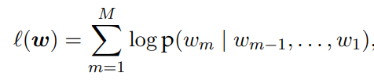
Evaluating language models: Held-out likelihood
The goal of probabilistic language models is to accurately measure the probability of sequences of word tokens.
Therefore, an intrinsic evaluation metric is the likelihood that the language model assigns to held-out data, which is not used during training.
We compute the following as we treat the entire held-out corpus as a single stream of tokens

Slide 26
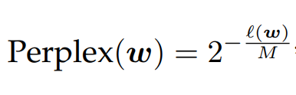
Evaluating language models: Perplexity
Held-out likelihood is usually presented as perplexity, which is a deterministic transformation of the log-likelihood into an information-theoretic quantity, where M is the total number of tokens in the held-out corpus:
Lower perplexities correspond to higher likelihoods, so lower scores are better on this metric.

Slide 27
Chapter 7
Sequence labeling

Slide 28
The goal of sequence labeling is to assign tags to words, or more generally, to assign discrete labels to discrete elements in a sequence.
we’ll focus on the classic problem of part-of-speech tagging, which requires tagging each word by its grammatical category.

Slide 29
Tags
DETERMINER ~ D
ADJECTIVE ~ J
NOUN ~ N
VERB ~ V
“The old man the boat” = {(The, D), (old, J), (man, N), (the, D), (boat, N)}

Slide 30
Parts of Speech
Open class words (or content words)
nouns, verbs, adjectives, adverbs
mostly content-bearing: they refer to objects, actions, and features in the world
open class, since there is no limit to what these words are, new ones are added all the time (email, website).
Closed class words (or function words)
pronouns, determiners, prepositions, connectives, …
there is a limited number of these
mostly functional: to tie the concepts of a sentence together

Slide 31
Why is POS tagging hard?
Ambiguity:
glass of water/NOUN vs. water/VERB the plants
lie/VERB down vs. tell a lie/NOUN
Sparse data:
Words we haven’t seen before (at all, or in this context)
Word-Tag pairs we haven’t seen before

Slide 32
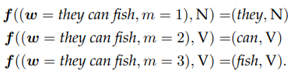
Sequence labeling as classification
One way to solve a tagging problem is to turn it into a classification problem.
This simple feature function then returns a single feature: a tuple including the word to be tagged and the tag that has been proposed.
Let f((w, m), y) indicate the feature function for tag y at position m in the sequence w = (w1, w2, . . . , wM) = “They can fish”.

Slide 33
Sequence labeling as classification
The feature function takes three input arguments: the sentence to be tagged, the proposed tag, and the index of the token
The feature function then returns a single feature: a tuple including the word to be tagged and the tag that has been proposed.
If the vocabulary size is V and the number of tags is K, then there are V × K features.
Each of these features must be assigned a weight. These weights can be learned from a labeled dataset using a classification algorithm.

Slide 34
Simple Classification Approach
Since each feature should be assigned a weight through a classification approach, let's consider a simple classification approach like following:
Assigning the weight θw,y = 1 for the tag y most frequently associated with word w.
Assigning the weight θw,y = 0 for all other tags.
Problem : It is easy to see that this simple classification approach cannot correctly tag both “they can fish” and “can of fish”, because can and fish are grammatically ambiguous.
Solution: the tagger must rely on context and the surrounding words.

Slide 35
Relevant knowledge for POS tagging
The word itself
Some words may only be nouns, e.g. arrow
Some words are ambiguous, e.g. fish, can
Probabilities may help, if one tag is more likely than another
Local context
two determiners rarely follow each other
two base form verbs rarely follow each other
determiner is almost always followed by adjective or noun

Slide 36
Context-Based Tagging
Including context into the feature set by incorporating the surrounding words as additional features.
Context features provide information that helps a tagger to choose the correct tag for the ambiguous words.
Example:
Choosing the right tag for the word “fish” in this sentence: “They can fish”
Words that come after “can” are likely to be verbs, so the feature (w_{m−1} = can, ym = V) should have a large positive weight
f ((w = they can fish, 1), N) = {(w_{m} = they, y_{m} = N), (w_{m−1} = Q, y_{m} = N), (w_{m+1} = can, y_{m}= N)}
f ((w = they can fish, 2), V) = {(w_{m} = can, y_{m} = V), (w_{m−1} = they, y_{m} = V), (w_{m+1} = fish, y_{m} = V)}
f ((w = they can fish, 3), V) = {(w_{m} = fish, y_{m} = V), (w_{m−1} = can, y_{m} = V), (w_{m+1} = □, y_{m} = V)}

Slide 37
Sequence labeling as structure prediction
Let's consider the entire sequence of tags as a label itself.
Sequence of words w = (w₁, w₂, . . . , w_{M} ) of length M.
Sequence’s set of possible taggings Y(w) = Y^{M}
In Y(w) = Y^{M} , Y = {N, V, D, ...} refers to the set of individual tags, and Y^{M} refers to the set of tag sequences of length M
We can then treat the sequence labeling problem as a classification problem in the label space Y(w)
yˆ = argmax Ψ(w, y)
y∈Y(w)
y = (y₁, y₂, . . . , y_{M} ) is a sequence of M tags,
Ψ is a scoring function on pairs of sequences, V ^{M} × Y^{M} → R.

Slide 38
Problem: In Reality.. Inference It’s intractable!
The problem of making a series of interconnected labeling decisions is known as inference.
In English:
Usual sentence’s length M = 20
Part-of-speech tag sets vary in size from 10 to several hundred.
We have |Y(w1:M)| ≈ 1020, one hundred billion billion possible tag sequences!!!
The label space is exponentially large in the length of the sequence M. Enumerating and scoring all the sequences makes inference an intractable problem.
Solution: restrict the scoring function to decompose into a sum of local parts of tag sequence.

Slide 39
Problem: Enumeration won’t work
Suppose we have c possible tags for each of the n words in the sentence.There are c*n possible tag sequences: the number grows exponentially in the length n.
Finding the best path?
The Viterbi algorithm finds this path without explicitly enumerating all paths. It finds the best tag sequence.

Slide 40
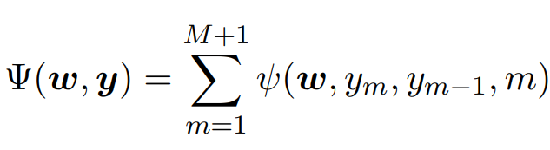


Solution : Restricted Local Scoring Function
Suppose we choose a function that decomposes into a sum of local parts.
Each ψ(·) scores a local part of the tag sequence
Special end-of-sequence tag,
Tag to begin the sequence,
In a linear model, local scoring function can be defined as a dot product of weights and features

Slide 41
Local Scoring Function in Linear Model
In a linear model, local scoring function can be defined as a dot product of weights and features.
The feature function would include features for word-tag pairs and tag-tag pairs.

Slide 42
Local Scoring Function in Linear Model
The feature function would include features for word-tag pairs (emission features) and tag-tag pairs (transition features)
Emission features provides information on which tags are appropriate for each word.
Transition features provide information on which tags tend to follow each other in sequence.
Low scores to infelicitous tag pairs, such as noun-determiner
High scores for frequent tag pairs, such as determiner-noun and noun-verb

Slide 43
Question :
“ how this restricted local scoring function enables efficient inference? ”
Answer :
“ Viterbi Algorithm for finding the optimal sequence of tags.”

Slide 44
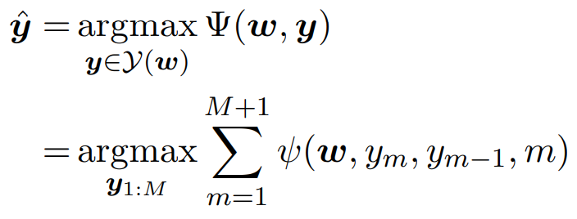

Inference and Dynamic Programming
By decomposing the scoring function into a sum of local parts, we have simplified of tagging problem.
This inference problem can be solved using dynamic programming.

Slide 45
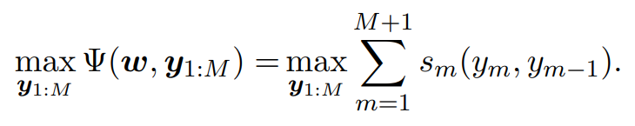
Inference and Dynamic Programming
We begin by solving an auxiliary problem.
Rather than finding the best tag sequence, we compute the score of the best tag sequence.

Slide 46
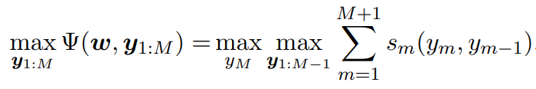
Inference and Dynamic Programming
The score in auxiliary problem involves a maximization over all tag sequences of length M.

Slide 47
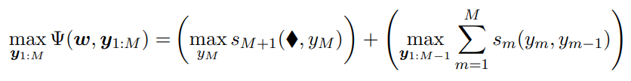
Inference and Dynamic Programming
The problem can be reformulated as a recurrence.
Within the sum, only the final term depends on yM to pull this term out of the second maximization.
The second term is in the form of our original problem with M replaced by M−1

Slide 48

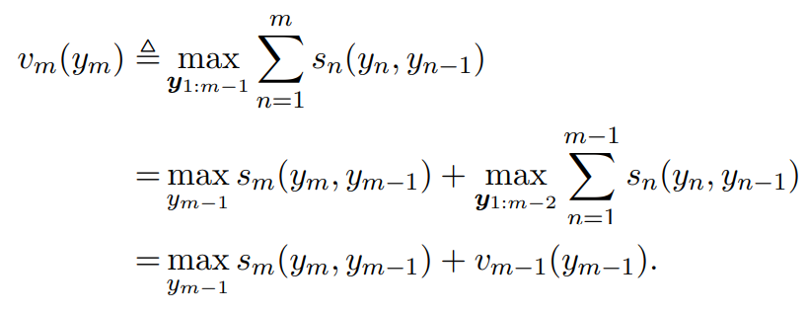
Viterbi
Let's define an auxiliary variable called the Viterbi variable , representing the score of the best sequence terminating in the tag k

Slide 49

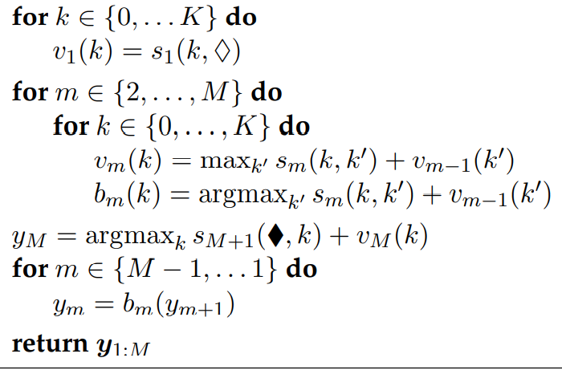
The Viterbi algorithm

Slide 50




The Viterbi algorithm
Each set of Viterbi variables gets computed from the local score and previous set of Viterbi variables
The initial condition of the recurrence is simply the score for the first tag.
The maximum overall score for the sequence is then the final Viterbi variable

Slide 51





Viterbi structure : Trellis
The Viterbi variables can be arranged in Trellis structure.
Each column indexes a token in the sequence
Each row indexes a tag in
Every is connected to every indicating that is computed from:
Special nodes are set aside for the start and end states.

Slide 52
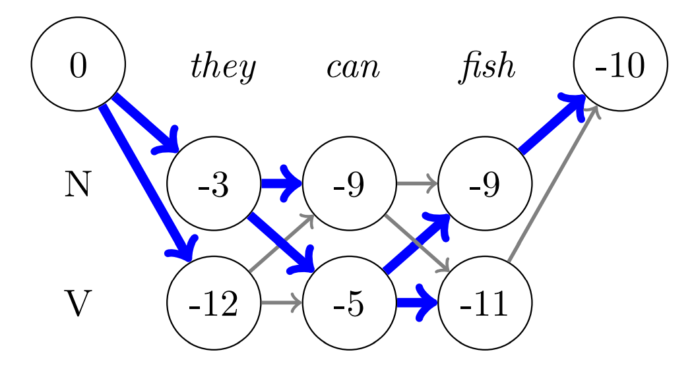
Example : Trellis Representation
For the example ‘they can fish’, using the weights:

Slide 53


Example : Trellis Representation
Each represents the score of the best tag sequence ending in that tag k in position m.
To compute this, we maximize over possible values of
By keeping track of the “argmax” tag that maximizes this choice at each step, we can walk backwards from the final tag, and recover the optimal tag sequence.

Slide 54

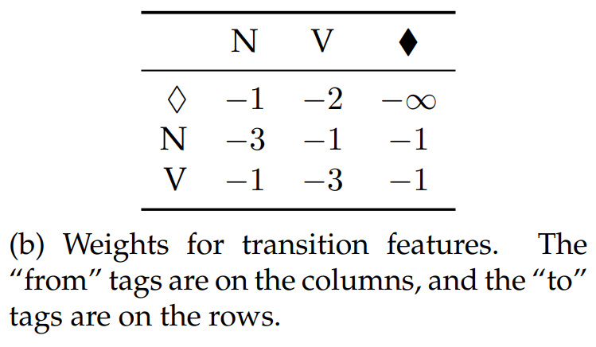
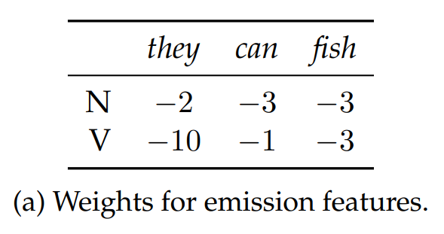
Example : Trellis Representation

Slide 55

Hidden Markov Models
Let's estimateVertibi scores probabilistically.
Due to Markov assumption, probabilistic sequence labeling models are hidden Markov models (HMMs)
By Naïve Bayes classifier as generative model, our goal is to select the tag sequence that maximizes

Slide 56
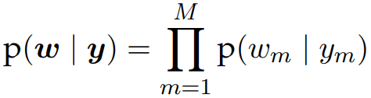
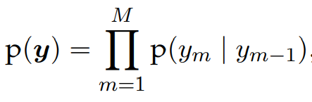

Hidden Markov Models
The tags are drawn from a prior distribution
The tokens are drawn from a conditional likelihood.
The probability of each token depends only on its tag, and not on any other element in the sequence:
Each tag depends only on its predecessor:

Slide 57
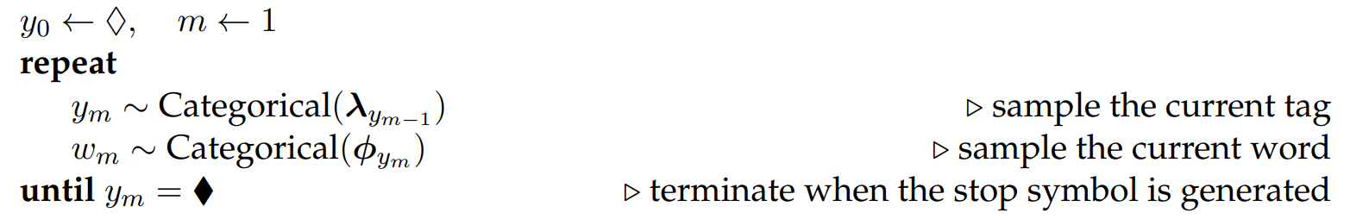
Hidden Markov Models
The generative process for the hidden Markov model is:
Given the parameters λ and φ, we can compute p(w, y) for any token sequence w and tag sequence y

Slide 58
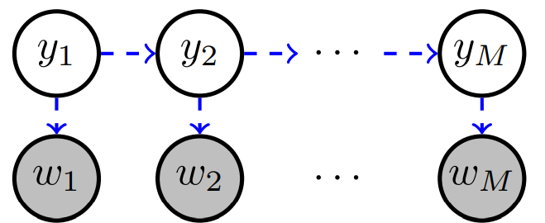



Graphical model of HMM
Arrows indicate probabilistic dependencies.
A non-adjacent pair of tags and are conditionally independent; if and we are given , then offers no additional information about

Slide 59


HMM Estimation
The Hidden Markov Model has two groups of parameters:
Emission probability: The words are treated as probabilistically “emitted”, conditioned on the tags.
Transition probability: It assigns probability to each possible tag-to-tag transition.

Slide 60
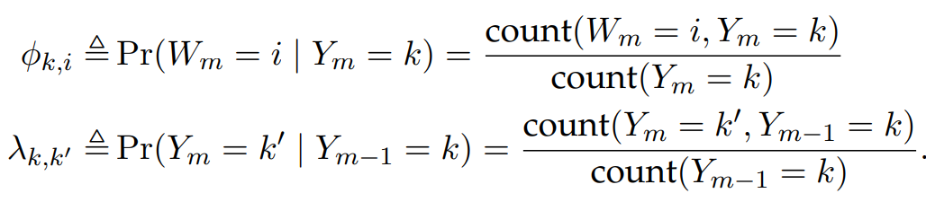
HMM Estimation
Both of these groups of parameters are typically computed from smoothed relative frequency estimation on a labeled corpus.
Unsmoothed probabilities are:

Slide 61


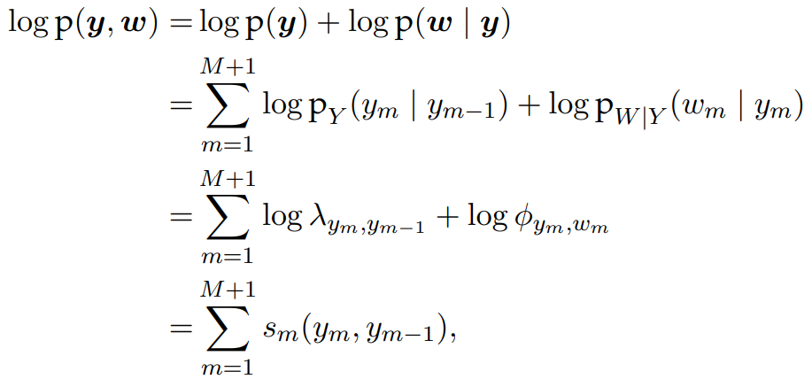
Inference in HMM
The goal of inference in the hidden Markov model is to find the highest probability tag sequence:
problem can be reformulated as:
We can now apply the HMM independence assumptions:

Slide 62
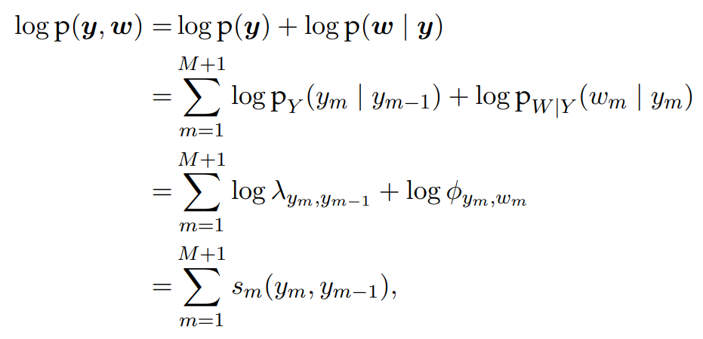
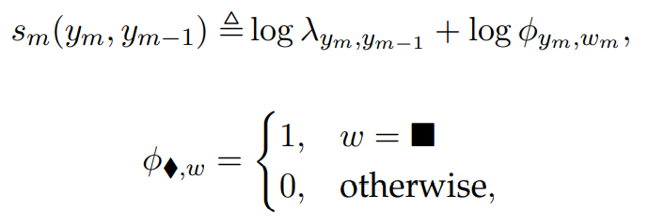
Inference in HMM
We can now apply the HMM independence assumptions:

Slide 63
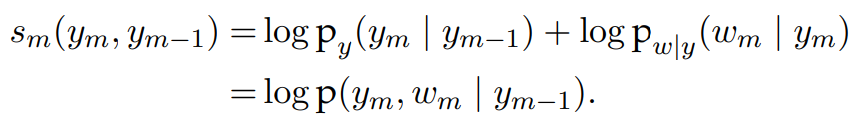
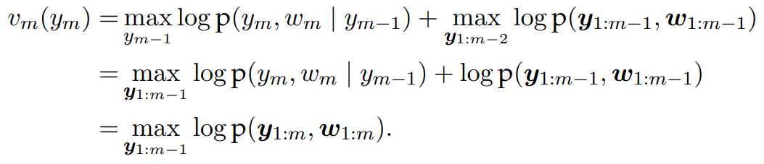
HMM inference and Viterbi decoding algorithm
The local score can be interpreted probabilistically:
Based on the definition of the Viterbi variables
We obtain the recurrence based on:

Slide 64
Neural sequence labeling
In neural network approaches to sequence labeling, we construct a vector representation for each tagging decision
This vector representation is based on the word and its context.
Neural networks perform tagging as a per-token classification decision, or they can be combined with the Viterbi algorithm to tag the entire sequence globally.

Slide 65





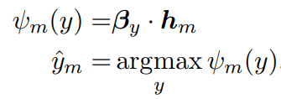
Recurrent Neural Networks
In Recurrent neural networks (RNNs), the context at token is summarized by a recurrently-updated vector
Where is the vector embedding of the token and the function defines the recurrence
A straightforward application of RNNs to sequence labeling is to score each tag as a linear function of

Slide 66

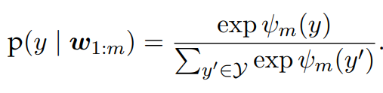
Recurrent Neural Networks
The score can also be converted into a probability distribution using the usual SoftMax operation
Using this transformation, it is possible to train the tagger from the negative log-likelihood of the tags, as in a conditional random field
Margin loss objective can also be constructed from the raw scores

Slide 67
Recurrent Neural Networks
Problem: The hidden state accounts for information in the input leading up to position , but it ignores the subsequent tokens, which may also be relevant to the tag .
Solution: This can be addressed by adding a second RNN and building a bidirectional recurrent neural network

Slide 68





Bidirectional Recurrent Neural Networks
By adding a second RNN, in which the input is reversed, running the recurrence from to
The hidden states of the left-to-right RNN are denoted
The left-to-right and right-to-left vectors are concatenated

Slide 69
Why Bidirectional Recurrent Neural Networks?
Bidirectional RNN tagging has several attractive properties.
Since summarizes the information from the surrounding context, it is not necessary to design explicit features to capture this information.
If the vector is an adequate summary of this context, then it may not even be necessary to perform the tagging jointly
Using backpropagation, the word vectors can be trained “end-to-end”, so that they capture word properties that are useful for the tagging task.
If limited labeled data is available, “pre-trained” word embeddings for unlabeled data can be employed:
Using a language modeling objective
Using word embedding technique
Combination of both fine-tuned and pre-trained embeddings in a single model.

Slide 70
Neural structure prediction
Sometimes, there are very strong dependencies between tags. In such scenarios, the tagging decision must be made jointly across the entire sequence.
Problem: The bidirectional recurrent neural network incorporates information from throughout the input, but each tagging decision is made independently
Solution: Neural sequence labeling can be combined with the Viterbi algorithm by defining the local scores as

Slide 71




Neural sequence labeling & Viterbi algorithm
is the RNN hidden state
is a vector associated with tag , and
is a scalar parameter for the tag transition
These local scores can then be incorporated into the Viterbi algorithm for inference, and into the forward algorithm for training
This model is called the LSTM-CRF, due to its combination of aspects of the long short-term memory and conditional random field models

Slide 72
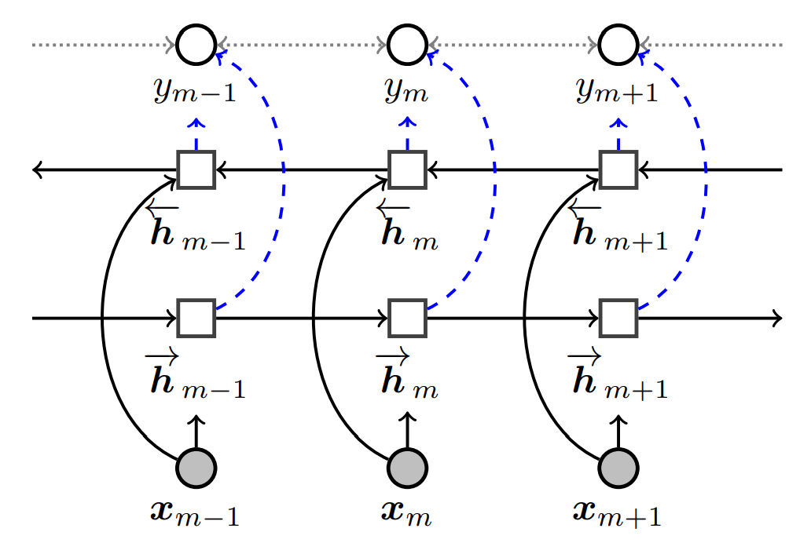
Neural sequence labeling & Viterbi algorithm
The solid lines indicate computation
The dashed lines indicate probabilistic dependency, and the dotted lines indicate the optional additional probabilistic dependencies between labels

